Slide 1


Python Dictionaries
Chapter 9
Python for Everybody
www.py4e.com
Notes:
Note from Chuck. If you are using these materials, you can remove the UM logo and replace it with your own, but please retain the CC-BY logo on the first page as well as retain the entire last page.

Slide 2
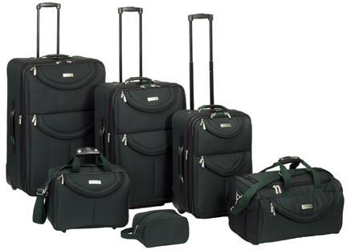
What is a Collection?
A collection is nice because we can put more than one value in it and carry them all around in one convenient package
We have a bunch of values in a single “variable”
We do this by having more than one place “in” the variable
We have ways of finding the different places in the variable

Slide 3
What is Not a “Collection”?
Most of our variables have one value in them - when we put a new value in the variable - the old value is overwritten
$ python
>>> x = 2
>>> x = 4
>>> print(x)
4

Slide 4
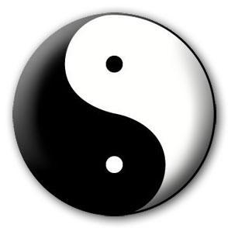
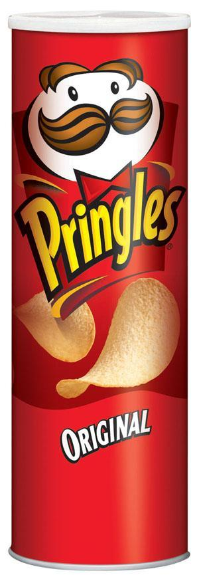

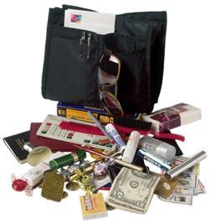
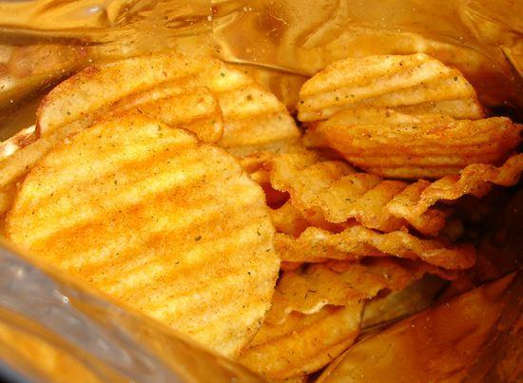
A Story of Two Collections..
List
- A linear collection of values that stay in order
Dictionary
- A “bag” of values, each with its own label

Slide 5
Dictionaries
tissue
calculator
perfume
money
candy
http://en.wikipedia.org/wiki/Associative_array

Slide 6
Dictionaries
Dictionaries are Python’s most powerful data collection
Dictionaries allow us to do fast database-like operations in Python
Dictionaries have different names in different languages
- Associative Arrays - Perl / PHP
- Properties or Map or HashMap - Java
- Property Bag - C# / .Net

Slide 7
Dictionaries
>>> purse = dict()
>>> purse['money'] = 12
>>> purse['candy'] = 3
>>> purse['tissues'] = 75
>>> print(purse)
{'money': 12, 'tissues': 75, 'candy': 3}
>>> print(purse['candy'])
3
>>> purse['candy'] = purse['candy'] + 2
>>> print(purse)
{'money': 12, 'tissues': 75, 'candy': 5}
Lists index their entries based on the position in the list
Dictionaries are like bags - no order
So we index the things we put in the dictionary with a “lookup tag”

Slide 8
Comparing Lists and Dictionaries
Dictionaries are like lists except that they use keys instead of numbers to look up values
>>> ddd = dict()
>>> ddd['age'] = 21
>>> ddd['course'] = 182
>>> print(ddd)
{'course': 182, 'age': 21}
>>> ddd['age'] = 23
>>> print(ddd)
{'course': 182, 'age': 23}
>>> lst = list()
>>> lst.append(21)
>>> lst.append(183)
>>> print(lst)
[21, 183]
>>> lst[0] = 23
>>> print(lst)
[23, 183]

Slide 9
>>> lst = list()
>>> lst.append(21)
>>> lst.append(183)
>>> print(lst)
[21, 183]
>>> lst[0] = 23
>>> print(lst)
[23, 183]
List
Key
Value
[0]
21
lst
[1]
183
>>> ddd = dict()
>>> ddd['age'] = 21
>>> ddd['course'] = 182
>>> print(ddd)
{'course': 182, 'age': 21}
>>> ddd['age'] = 23
>>> print(ddd)
{'course': 182, 'age': 23}
Dictionary
Key
Value
['course']
182
ddd
['age']
21

Slide 10
Dictionary Literals (Constants)
Dictionary literals use curly braces and have a list of key : value pairs
You can make an empty dictionary using empty curly braces
>>> jjj = { 'chuck' : 1 , 'fred' : 42, 'jan': 100}
>>> print(jjj)
{'jan': 100, 'chuck': 1, 'fred': 42}
>>> ooo = { }
>>> print(ooo)
{}
>>>

Slide 11
Dictionary Tracebacks
It is an error to reference a key which is not in the dictionary
We can use the in operator to see if a key is in the dictionary
>>> ccc = dict()
>>> print(ccc['csev'])
Traceback (most recent call last):
File "<stdin>", line 1, in <module>
KeyError: 'csev'
>>> 'csev' in ccc
False

Slide 12
The get Method for Dictionaries
The pattern of checking to see if a key is already in a dictionary and assuming a default value if the key is not there is so common that there is a method called get() that does this for us
if name in counts:
x = counts[name]
else :
x = 0
x = counts.get(name, 0)
Default value if key does not exist (and no Traceback).
{'csev': 2, 'zqian': 1, 'cwen': 2}

Slide 13
Definite Loops and Dictionaries
Even though dictionaries are not stored in order, we can write a for loop that goes through all the entries in a dictionary - actually it goes through all of the keys in the dictionary and looks up the values
>>> counts = { 'chuck' : 1 , 'fred' : 42, 'jan': 100}
>>> for key in counts:
... print(key, counts[key])
...
jan 100
chuck 1
fred 42
>>>

Slide 14
Retrieving Lists of Keys and Values
>>> jjj = { 'chuck' : 1 , 'fred' : 42, 'jan': 100}
>>> print(list(jjj))
['jan', 'chuck', 'fred']
>>> print(jjj.keys())
['jan', 'chuck', 'fred']
>>> print(jjj.values())
[100, 1, 42]
>>> print(jjj.items())
[('jan', 100), ('chuck', 1), ('fred', 42)]
>>>
You can get a list of keys, values, or items (both) from a dictionary
What is a “tuple”? - coming soon...

Slide 15

Summary

Slide 16
Acknowledgements / Contributions
These slides are Copyright 2010- Charles R. Severance (www.dr-chuck.com) of the University of Michigan School of Information and open.umich.edu and made available under a Creative Commons Attribution 4.0 License. Please maintain this last slide in all copies of the document to comply with the attribution requirements of the license. If you make a change, feel free to add your name and organization to the list of contributors on this page as you republish the materials.
Initial Development: Charles Severance, University of Michigan School of Information
… Insert new Contributors or translation credits here
...

